Slide 1
Polymorphism

Slide 2
Learning Objectives
Understand the concept of polymorphism.
Explore the types of polymorphism.
Learn how to implement polymorphism in programming.
Grasp its importance in real-world applications.

Slide 3
What is Polymorphism?
Definition: Polymorphism means "many forms." It allows one interface to be used for different underlying forms (data types or classes).
Key Idea:
A single action can behave differently based on the context.
Real-world Example:
The word "run" has different meanings: run a race, run a program, or run a machine.

Slide 4
Why Polymorphism?
Promotes flexibility in code design.
Enhances code reusability and readability.
Supports scalable and maintainable software development.
Encourages loose coupling between objects.

Slide 5
Types of Polymorphism
Compile-time Polymorphism (Static Binding):
Achieved through method overloading or operator overloading.
The method to be executed is determined at compile time.
Run-time Polymorphism (Dynamic Binding):
Achieved through method overriding.
The method to be executed is determined at runtime.

Slide 6
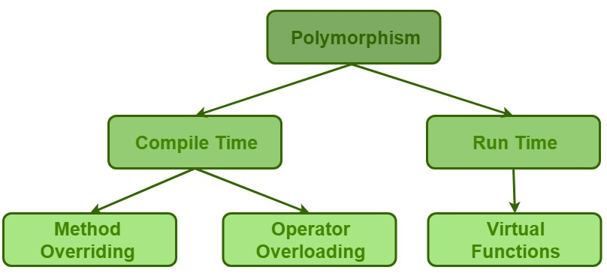

Slide 7
Compile-time Polymorphism
Definition: Method or function behavior is determined at compile time.
How it's achieved:
Method Overloading: Multiple methods with the same name but different parameters.
Operator Overloading: Redefining the functionality of operators for user-defined data types.

Slide 8
Run Time Polymorphism
Definition: Behavior is determined at runtime based on the object's type.
How it's achieved:
Method Overriding: A subclass provides a specific implementation of a method declared in its superclass.
Requires inheritance and a base-class reference or pointer.

Slide 9
Advantages of Polymorphism
Simplifies code and reduces redundancy.
Makes systems more extensible.
Improves functionality in object-oriented systems.
Encourages the use of interfaces and abstractions.

Slide 10
Compile Time
Definition: The period when the source code is translated into machine code (executable format) by a compiler.
Key Activities:
Syntax checking.
Type checking (ensuring variables and functions are used correctly according to their declared types).
Memory allocation for static variables and constants.
Compilation errors like missing semicolons, undeclared variables, or type mismatches are detected.

Slide 11
Compile Time Examples
Declaring variables without a type
int x; // Compiles successfully.
y = 5; // Compile-time error: `y` is not declared.
Syntax errors
cout << "Hello World" // Missing semicolon causes a compile-time error.

Slide 12
Run Time
Definition: The period when the compiled program is executed.
Key Activities:
Dynamic memory allocation.
Input/output operations.
Actual execution of program logic.
Runtime errors, such as division by zero or accessing invalid memory, may occur.

Slide 13
Run Time Examples
Division by zero
int x = 10, y = 0;
cout << x / y; // Runtime error: Division by zero.
File not found
ifstream file("nonexistent.txt");
if (!file) {
cout << "File not found!"; // Detected at runtime.
}

